Slide 1
How to use this PowerPoint template
Please follow the steps in the notes section under the slides carefully.
Delete the slides or placeholders you do not wish to include in your presentation.
More slides can be added from the Insert > New Slide option.

Slide 2



Photo by Stefan Els
Notes:
Picture placeholder slide layout
To change the picture:
Select the picture by clicking on it near the bottom of the slide (under the title placeholder), then click on the Picture Format tab.
Click on the Change Picture icon and choose the From a File/This Device… option.
Browse and select a picture and click on the Insert button.
Use the Crop command to adjust the image.
Click on the Crop command again to apply the changes.
Remember to add image attributions to photographs or artworks.

Slide 3


Photo by Stefan Els
Notes:
Picture placeholder slide layout
To change the picture:
Select the picture by clicking on it near the bottom of the slide (under the title placeholder), then click on the Picture Format tab.
Click on the Change Picture icon and choose the From a File/This Device… option.
Browse and select a picture and click on the Insert button.
Use the Crop command to adjust the image.
Click on the Crop command again to apply the changes.
Remember to add image attributions to photographs or artworks.

Slide 4

Photo by Stefan Els
Notes:
Picture placeholder slide layout
To change the picture:
Select the picture by clicking on it near the bottom of the slide (under the title placeholder), then click on the Picture Format tab.
Click on the Change Picture icon and choose the From a File/This Device… option.
Browse and select a picture and click on the Insert button.
Use the Crop command to adjust the image.
Click on the Crop command again to apply the changes.
Remember to add image attributions to photographs or artworks.

Slide 5
Notes:
Solid maroon background slide
The ghost text placeholder is fully scalable and movable.
To add a background image:
Right-click on the slide and choose Format Background …
Click on the Picture or texture fill option and click on the Insert button.
Browse and select a picture and click on the Insert button.
Remember to add image attributions to photographs or artworks.

Slide 6



Photo by Stefan Els
Notes:
Cover/End slide layout
To change the picture:
Select the picture by clicking on it near the bottom of the slide (under the title placeholder), then click on the Picture Format tab.
Click on the Change Picture icon and choose the From a File/This Device… option.
Browse and select a picture and click on the Insert button.
Use the Crop command to adjust the image.
Click on the Crop command again to apply the changes.
Remember to add image attributions to photographs or artworks.

Slide 7

Photo by Stefan Els
Notes:
Cover/End slide layout
To change the picture:
Select the picture by clicking on it near the bottom of the slide (under the title placeholder), then click on the Picture Format tab.
Click on the Change Picture icon and choose the From a File/This Device… option.
Browse and select a picture and click on the Insert button.
Use the Crop command to adjust the image.
Click on the Crop command again to apply the changes.
Remember to add image attributions to photographs or artworks.

Slide 8



Photo by Stefan Els
Notes:
Cover/End slide layout
To change the picture:
Select the picture by clicking on it near the bottom of the slide (under the title placeholder), then click on the Picture Format tab.
Click on the Change Picture icon and choose the From a File/This Device… option.
Browse and select a picture and click on the Insert button.
Use the Crop command to adjust the image.
Click on the Crop command again to apply the changes.
Remember to add image attributions to photographs or artworks.

Slide 25

Thank you Enkosi Dankie
Photo by Stefan Els
Notes:
Cover/End slide layout
To change the picture:
Select the picture by clicking on it near the bottom of the slide (under the title placeholder), then click on the Picture Format tab.
Click on the Change Picture icon and choose the From a File/This Device… option.
Browse and select a picture and click on the Insert button.
Use the Crop command to adjust the image.
Click on the Crop command again to apply the changes.
Remember to add image attributions to photographs or artworks.

Slide 26
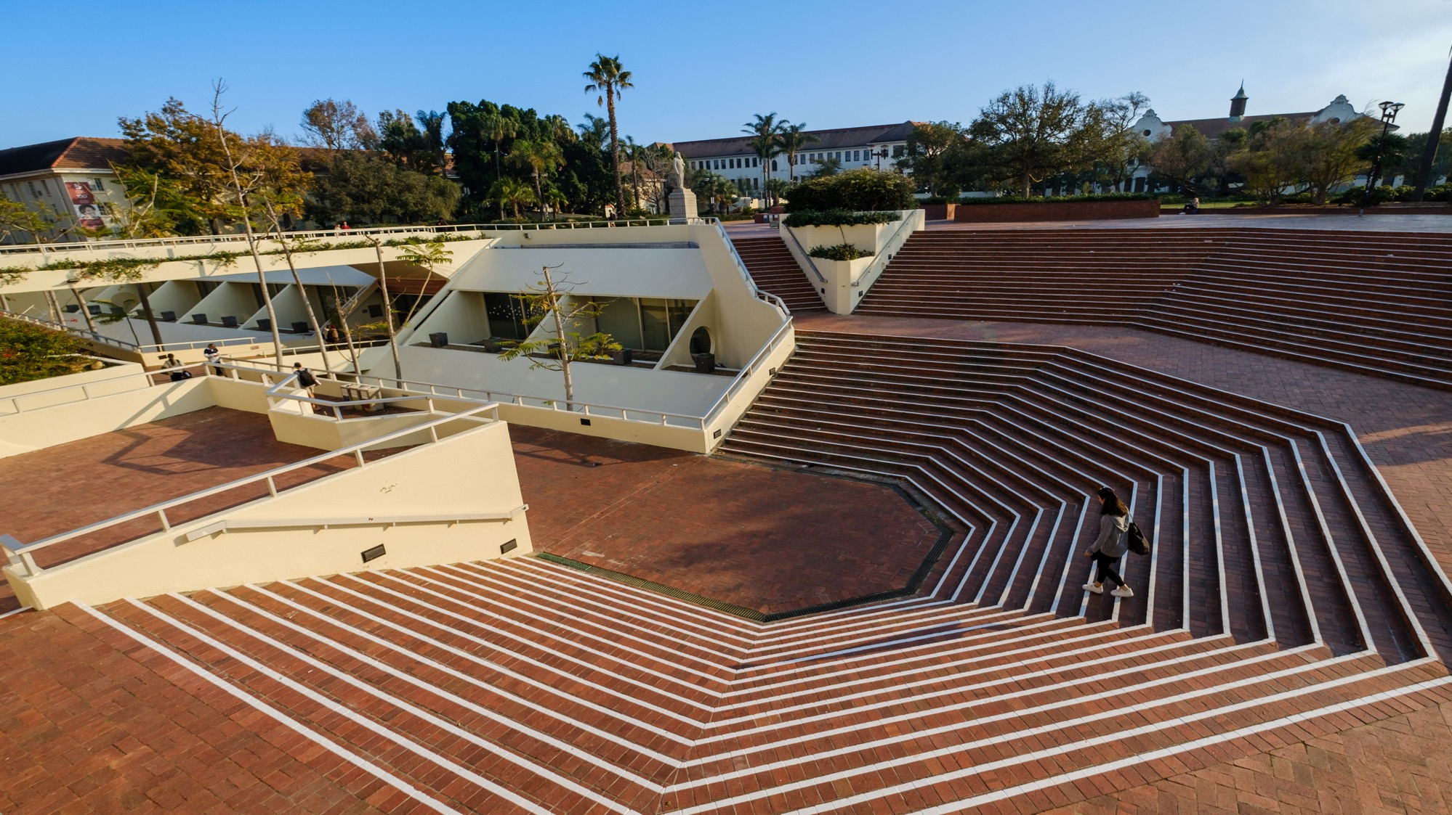

Thank you Enkosi Dankie
Photo by Stefan Els
Notes:
Cover/End slide layout
To change the picture:
Select the picture by clicking on it near the bottom of the slide (under the title placeholder), then click on the Picture Format tab.
Click on the Change Picture icon and choose the From a File/This Device… option.
Browse and select a picture and click on the Insert button.
Use the Crop command to adjust the image.
Click on the Crop command again to apply the changes.
Remember to add image attributions to photographs or artworks.

